Slide 1

UNIX Programming
Chapter 1

Slide 2
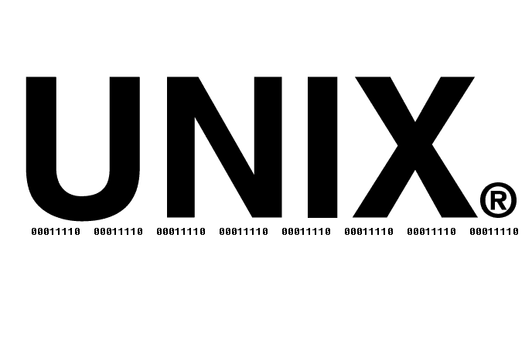

1. History and Standards
Linux is a member of the UNIX family of operating systems. In computing terms, UNIX has a long history.
One of the notable features of UNIX system is that its development was not controlled by a single vendor or organization. Rather, many groups contributed to its evolution.

Slide 3
1.1 A Brief History of UNIX and C
The first UNIX implementation was developed in 1969 (the same year that Linus Torvalds was born) by Ken Thompson at Bell Laboratories, a division of the telephone corporation, AT&T.
It was written in assembler for a Digital PDP-7 minicomputer.
The name UNIX was a pun on MULTICS (Multiplexed Information and Computing Service), the name of an earlier operating system project in which AT&T collaborated with Massachusetts Institute of Technology (MIT) and General Electric. (AT&T had by this time withdrawn from the project in frustration at its initial failure to develop an economically useful system.)

Slide 4
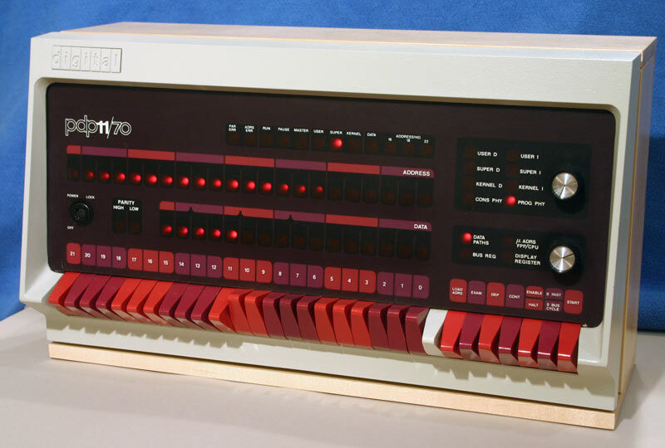
1.1 A Brief History of UNIX and C
In 1970, UNIX was rewritten in assembly language for a newly acquired Digital PDP-11 minicomputer, then a new and powerful machine. Vestiges of this PDP-11 heritage can be found in various names still used on most UNIX implementations, including Linux

Slide 5
1.1 A Brief History of UNIX and C
A short time later, Dennis Ritchie, one of Thompson’s colleagues at Bell Laboratories and an early collaborator on UNIX, designed and implemented the C programming language. This was an evolutionary process; C followed an earlier interpreted language, B.
B was initially implemented by Thompson and drew many of its ideas from a still earlier programming language named BCPL. By 1973, C had matured to a point where the UNIX kernel could be almost entirely rewritten in the new language.
UNIX thus became one of the earliest operating systems to be written in a high-level language, a fact that made subsequent porting to other hardware architectures possible.

Slide 6
1.1 A Brief History of UNIX and C
The genesis of C explains why it, and its descendant C++, have come to be used so widely as system programming languages today.
Previous widely used languages were designed with other purposes in mind:
FORTRAN for mathematical tasks performed by engineers and scientists
COBOL for commercial systems processing streams of record-oriented data.
UNIX went through many versions, named editions, most of them named by their edition number (First, Second, etc.)

Slide 7
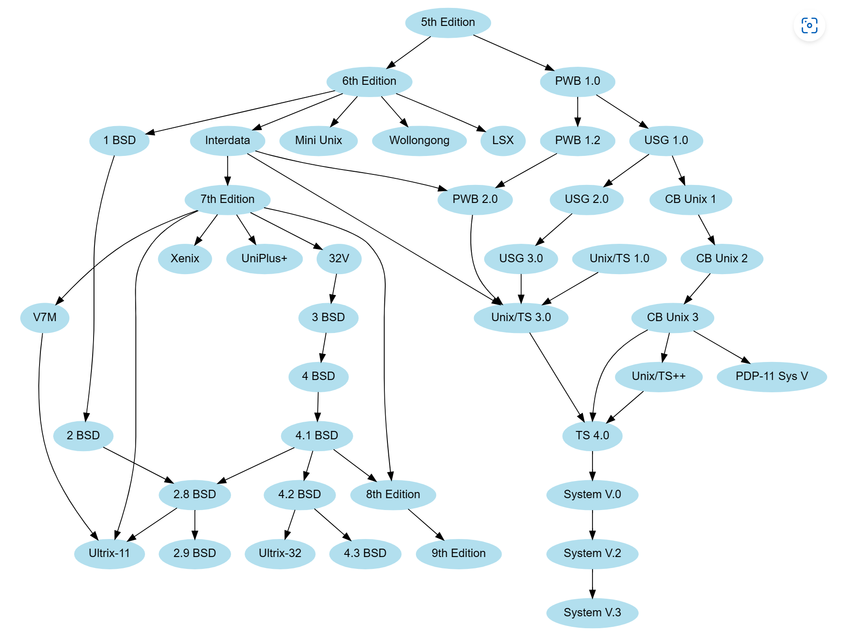

Slide 8

1.1 A Brief History of Linux
The term Linux is commonly used to refer to the entire UNIX-like operating system of which the Linux kernel forms a part. However, this is something of a misnomer, since many of the key components contained within a typical commercial
Linux distribution actually originates from a project that predates the inception of Linux by several years.

Slide 9
1.2.1 The GNU Project
In 1984, Richard Stallman, an exceptionally talented programmer who had been working at MIT, set to work on creating a “free” UNIX implementation
In response, Stallman started the GNU project (a recursively defined acronym for “GNU’s not UNIX”) to develop an entire, freely available, UNIX-like system, consisting of a kernel and all associated software packages, and encouraged others to join him
By the early 1990s, the GNU project had produced a system that was virtually complete, except for one important component: a working UNIX kernel. The GNU project had started work on an ambitious kernel design, known as the GNU/HURD, based on the Mach microkernel. However, the HURD was far from being in a form that could be released

Slide 10
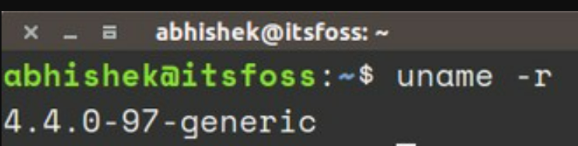
1.2.2 The Linux Kernel
Linus Torvalds is the author of the first versions of the Linux kernel.
Like most free software projects, Linux follows a release-early, release-often model, so that new kernel revisions appear frequently (sometimes even daily). As the Linux user base increased, the release model was adapted to decrease disruption to existing users.
Specifically, following the release of Linux 1.0, the kernel developers adopted a kernel version numbering scheme with each release numbered x.y.z: x representing a major version, y a minor version within that major version, and z a revision of the minor version (minor improvements and bug fixes).

Slide 11
Linux Distributions
The earliest distributions appeared in 1992, and included MCC Interim Linux (Manchester Computing Centre, UK), TAMU (Texas A&M University), and SLS (SoftLanding Linux System).
The oldest surviving commercial distribution, Slackware, appeared in 1993.
The noncommercial Debian distribution appeared at around the same time, and SUSE and Red Hat soon followed.
The currently very popular Ubuntu distribution first appeared in 2004.
Nowadays, many distribution companies also employ programmers who actively contribute to existing free software projects or initiate new projects.

Slide 12
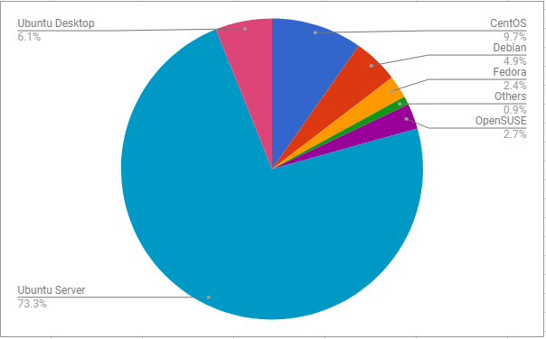
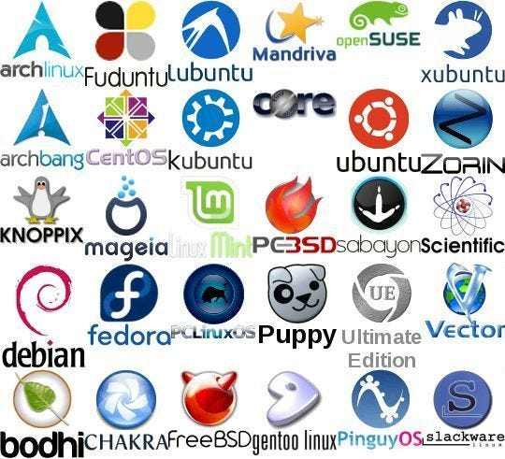

Slide 13
1.4 Summary
The UNIX system was first implemented in 1969 on a Digital PDP-7 minicomputerby Ken Thompson at Bell Laboratories (part of AT&T)
Two different currents led to the development of (GNU/) Linux. One of these was the GNU project, founded by Richard Stallman. In 1991, inspired by the Minixkernel written by Andrew Tanenbaum, Linus Torvalds produced a working UNIX kernel for the Intel x86-32 architecture.
Unlike most commercial UNIX implementations, Linux separates implementation from distribution. Consequently, there is no single “official” Linux distribution. Each Linux distributor’s offering consists of a snapshot of the current stable kernel, with various patches applied.

Slide 14
Additional Resources
Why so many distros? The Weird History of Linux - YouTube

